Slide 1
Confidence intervals and testing
Day 2

Slide 2
Notes
Problem set
  I don’t know why the homework says Homework 11; sorry about that!
  “In particular, Problem 10 may be close to the 5% threshold.” no longer applies after I cut some problems.
  This problem set gives you practice with calculating SE, CI, etc. by hand and running through the inference routine. It will feel repetitive, and that’s intentional!
The lab is based on understanding inference and how to make decisions from it
Today:
  Finish slides from last class + a couple examples
  Based on Tuesday and today, we’ll do a challenge, competing against the other sections!
  If we get to it, we will run through a coding example on the metabric data. If not, you have access to the code: inference_WITH_METABRIC_EXAMPLE.ipynb This is like the code for the Ames regression, and may help you with your homework

Slide 3
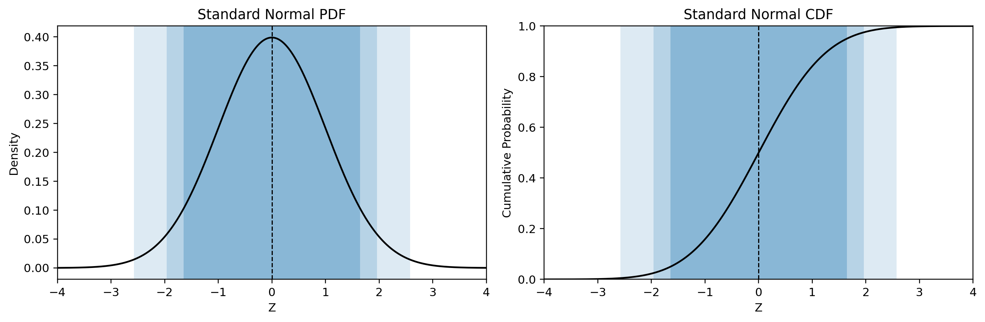
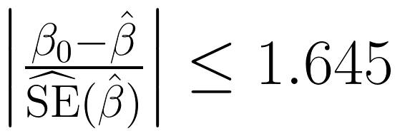
Just Memorize These
Instead of taking the quantiles of our bootstrap sample, take the quantiles of the standard Normal, then invert the z-score normalization
Confidence | Lower | Upper | Level (α)
90% | −1.645 | +1.645 | .10
95% | −1.960 | +1.960 | .05
99% | −2.576 | +2.576 | .01
So the 90% CI comes from this bound:

Slide 4
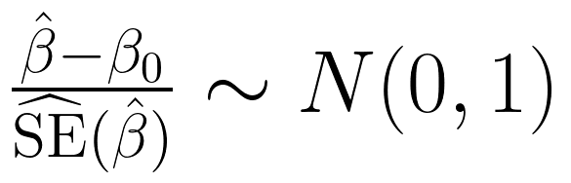
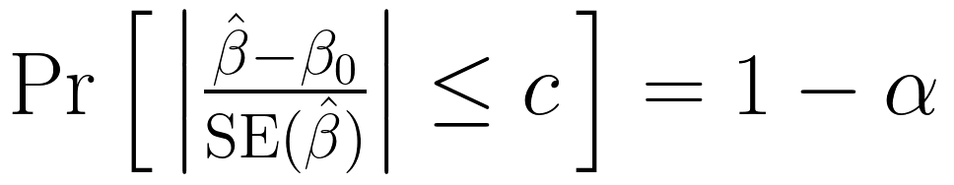
What Is a Confidence Interval?
Suppose our estimator is approximately normally distributed:
Choose a critical value c such that:
What is random? The interval, because β̂ changes with every sample. What is fixed? β₀. The 95% describes the procedure, not any one interval
Rearrange to get:
This is a statistical reliability claim, not a statement about the value of the true parameter β₀
Notes:
Our z-scored normalized estimator beta hat is approximately normally distributed
The probability that the magnitude of the z score normalized difference between our estimate and some null value beta 0 is less than a critical value, c, is 1-alpha
Our estimator is random, NOT beta 0

Slide 5
Constructing Confidence Intervals

Slide 6
Thought Experiment: Would the CLT work in each case?
For each one: does "estimate ± 1.96 SE" work for a 95% CI? If not, what breaks down each time?
1. You survey 100 students that come in 10 friend groups whose members answer the same way
2. You average the profit ratio (this year's profit ÷ last year's) across 100 stores, where many stores roughly broke even last year
3. A condition affects 1 in 100 people. You test 100 people and find 0 cases
4. You bootstrap the largest sale price in the Ames data
5. You poll 10,000 people, but only those who answer a landline at 2 pm
Notes:
1. Dependence. The 100 answers carry about 10 independent pieces of information, so s/√100 is too small
2. Infinite variance. A store that broke even has a denominator near 0, so one ratio can be enormous, of either sign. Ratios like this have Cauchy-type tails: the mean of 100 is as spread out as a single ratio
3. Too little data for the skew. Pr[0 cases] = 0.99¹⁰⁰ = 0.37. Then p̂ = 0, SE = 0, and the "95% CI" is [0, 0]
4. Not a sum. The max is not an average of many pieces. A resample can never exceed the sample's largest price, so the bootstrap max piles up at one value
5. Wrong target. The CLT still holds: x̄ is normal around the mean of landline-at-2-pm answerers. The interval is precise about the wrong number, and more data only makes it more confidently wrong
Estimate ± 1.96 SE can fail because the CLT fails (2, 4), the SE is wrong (1, 3), or the target is wrong (5)

Slide 7
Thought Experiment: Answers
1. Dependence. The 100 answers carry about 10 independent pieces of information, so s/√100 is too small
2. Infinite variance. A store that broke even has a denominator near 0, so one ratio can be enormous, of either sign. Ratios like this have Cauchy-type tails: the mean of 100 is as spread out as a single ratio
3. Too little data for the skew. Pr[0 cases] = 0.99¹⁰⁰ = 0.37. Then p̂ = 0, SE = 0, and the "95% CI" is [0, 0]
4. Not a sum. The max is not an average of many pieces. A resample can never exceed the sample's largest price, so the bootstrap max piles up at one value
5. Wrong target. The CLT still holds: x̄ is normal around the mean of landline-at-2-pm answerers. The interval is precise about the wrong number, and more data only makes it more confidently wrong
Estimate ± 1.96 SE can fail because the CLT fails (2, 4), the SE is wrong (1, 3), or the target is wrong (5)

Slide 8
Confidence interval calculation exercise
You run a regression and get a coefficient of 10 with a standard error of 5 for a key coefficient
Compute 90/95/99% confidence intervals for the coefficient
For which levels of confidence is a statistically significant difference from 0 detected?
Notes:
Answer: 90% (1.78, 18.23); 95% (0.20, 19.80); 99% (−2.88, 22.88). Significant at 90% and 95%, not at 99%.
Coefficient 10, SE 5
90% CI: (10 − 1.645 × 5, 10 + 1.645 × 5) = (1.78, 18.23)
95% CI: (10 − 1.960 × 5, 10 + 1.960 × 5) = (0.20, 19.80)
99% CI: (10 − 2.576 × 5, 10 + 2.576 × 5) = (−2.88, 22.88)
Significantly different from 0 at 90% and 95% (0 is outside), but not at 99% (0 is inside)
Shortcut: the estimate is 10/5 = 2 SEs from 0. It's significant whenever 2 beats the critical value: 2 > 1.645, 2 > 1.960, 2 < 2.576

Slide 9
Exercise: Answers
Coefficient 10, SE 5
90% CI: (10 − 1.645 × 5, 10 + 1.645 × 5) = (1.78, 18.23)
95% CI: (10 − 1.960 × 5, 10 + 1.960 × 5) = (0.20, 19.80)
99% CI: (10 − 2.576 × 5, 10 + 2.576 × 5) = (−2.88, 22.88)
Significantly different from 0 at 90% and 95% (0 is outside), but not at 99% (0 is inside)
Shortcut: the estimate is 10/5 = 2 SEs from 0. It's significant whenever 2 beats the critical value: 2 > 1.645, 2 > 1.960, 2 < 2.576

Slide 10
CI to Hypothesis Test: TEST = INTERVAL
If we hypothesize β₀ takes some value, usually zero, this becomes a hypothesis test: is the hypothesized value β₀ in the interval or not?
Is β₀ (often 0) outside the CI? If so, reject H₀; if it is inside the CI, fail to reject H₀

Slide 11
From Test to p-Value
The test on the last slide, like a confidence interval, gives a yes/no at one α. The p-value tells you every α at which you would reject
Compute z = (estimate − θ₀) / SE, then p = 2Φ(−|z|): the probability, if the null were true, of an estimate at least as far from θ₀ as ours
Coefficient 10, SE 5: z = 2, so p = 2Φ(−2) = 0.046. Reject at α = .10 and .05, not at .01: the same answers the 90/95/99% CIs gave
Reject H₀ exactly when p < α, which is exactly when θ₀ is outside the (1 − α) CI. Same information, two ways to report it
The p-value is not the probability that H₀ is true. It is computed assuming H₀ is true

Slide 12
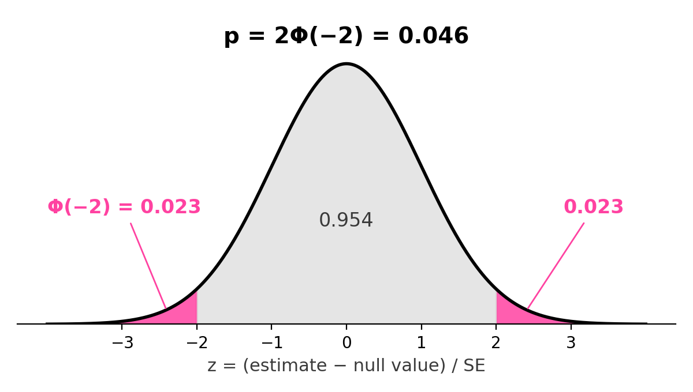
Where Φ Comes In
Φ is the standard normal CDF: Φ(z) is the area under the N(0, 1) curve to the left of z
By symmetry, Φ(−2) = 0.023 is also the area to the right of +2. 2Φ(−|z|) adds both tails: estimates at least this far from the null, in either direction
It is the same function behind the critical values: Φ(−1.96) = 0.025, so 2Φ(−1.96) = 0.05. That is where 1.96 comes from
In Python: from scipy.stats import norm, then p = 2 * norm.cdf(-abs(z))
Going the other way, Φ⁻¹ gives critical values: norm.ppf(0.975) = 1.96
Remember, the area under the PDF curve to the left of z = CDF evaluated at z

Slide 13
The CI Is Not...
the probability that β₀ is in the interval you computed
It couldn't be this: we don't know the true β₀
If β₀ was random, and had a distribution associated with it, then you'd use Bayes' Rule to observe data and update that distribution
We often say things like, "Gravity is −9.81 m/s²." We don't often say things like, "Gravity is normally distributed with mean −9.81 m/s² and standard deviation .0051"
If you did talk like that, you'd be a Bayesian statistician, and we'll talk about Bayesian statistics at the end of the course

Slide 14
The CI Is...
If we did this kind of analysis many times, what range of values is plausible for our estimates?
A set of parameter values that our data do not allow us to reject, using a procedure designed to exclude the true parameter only a specified fraction of the time (the Type 1 error probability).
The probability that the random CI covers the true β₀ is 1 − α; we expect the CI to cover the true β₀ with probability 1 − α
If we repeatedly sampled data and constructed a new confidence interval each time, approximately 95% of those intervals would contain the fixed, unknown parameter β₀ (the bootstrapping connection is clear here)

Slide 15
Coverage You Can Count
Population {1, 3, 5}, draw n = 2 with replacement, so μ = 3
Listing out all 9 possible samples and their x̄
1. Our interval rule is x̄ ± 1.5. Normally, we don’t know exactly from how many samples would contain the true mean, because don’t know what the true mean is. Instead, we use the CLT and normal curve to figure out the coverage of an interval. Here, we do know the true mean. For how many of the 9 samples does the interval contain μ = 3? What is the coverage?
2. You drew (1, 1), so your interval is [−0.5, 2.5]. What is the probability that this interval contains μ?
sample | (1,1) | (1,3) | (1,5) | (3,1) | (3,3) | (3,5) | (5,1) | (5,3) | (5,5)
x̄ | 1 | 2 | 3 | 2 | 3 | 4 | 3 | 4 | 5
Notes:
Back to {1, 3, 5} with n = 2: μ = 3, and the 9 sample means are 1, 2, 3, 2, 3, 4, 3, 4, 5
The rule "x̄ ± 1.5" covers μ when x̄ ∈ {2, 3, 4}: 7 of the 9 samples
So x̄ ± 1.5 is a 78% confidence interval, by counting
Zero. [−0.5, 2.5] misses 3, and nothing random is left once you've drawn your sample. The 78% belongs to the rule, not to your interval

Slide 16
Coverage You Can Count: Answers
Back to {1, 3, 5} with n = 2: μ = 3, and the 9 sample means are 1, 2, 3, 2, 3, 4, 3, 4, 5
The rule "x̄ ± 1.5" covers μ when x̄ ∈ {2, 3, 4}: 7 of the 9 samples
So x̄ ± 1.5 is a 78% confidence interval, by counting
Zero. [−0.5, 2.5] misses 3, and nothing random is left once you've drawn your sample. The 78% belongs to the rule, not to your interval
coverage is a property of the rule, computed over all samples before you see yours

Slide 17
Comparing Two Groups: the SE of a Difference
Drug trial: 25 patients on the standard drug (A) live an average of 10 months; 25 on a new drug (B) live 13. SD = 5 in each group, so each SE = 5/√25 = 1
We care about the gap: x̄_{B} − x̄_{A} = 3 months. What is its SE?
For independent groups, variances add: V[x̄_{B} − x̄_{A}] = V[x̄_{B}] + V[x̄_{A}] = 1 + 1 = 2, so SE = √2 = 1.41
SEs do not add (1 + 1 = 2 is wrong). In general: SE(gap) = √(SE_{A}² + SE_{B}²). Bootstrap version: resample each group separately, compute the gap each time, take the SD of the gaps

Slide 18
Comparing Two Groups: a CI for the Difference
95% CI for the gap: 3 ± 1.96 × 1.41 = 3 ± 2.77 = (0.23, 5.77). 0 is outside, so the new drug adds months at α = .05
To get z, remember we will do estimated difference (3) – null difference (0) divided by SE:
z = 3 / 1.41 = 2.12, and p = 2Φ(−2.12) = 0.03
But each drug’s own 95% CI is (8.04, 11.96) for A and (11.04, 14.96) for B: they overlap
Overlapping CIs do not mean “no difference.” But non-overlapping CIs DO mean a difference.
Rule of thumb (independent groups, similar SEs): 95% CIs that just touch give p ≈ 0.006, and they can overlap by about half an arm and still give p < .05

Slide 19
Paired Data: Take Differences First
Crossover migraine trial: the same 30 patients spend a month on placebo (A) and a month on the drug (B). Averages: 10 and 11.5 migraine-free days; SE = 1 each
As if the groups were independent: SE(gap) = √(1 + 1) = 1.41, z = 1.5/1.41 = 1.06, p ≈ 0.29
But patients with frequent migraines have few good days in both months, so each patient’s two counts are correlated (r ≈ 0.8)
Take each patient’s difference d = B − A first, then do a one-sample CI on the 30 d’s: SE = s_{d}/√30 = 0.63, CI = 1.5 ± 1.24 = (0.26, 2.74), p ≈ 0.02
Why: V[x̄_{B} − x̄_{A}] = V[x̄_{A}] + V[x̄_{B}] − 2Cov(x̄_{A}, x̄_{B}). Positive correlation shrinks the SE, and two separate CIs can’t show it

Slide 20
If you are getting confused about what to calculate… you can’t go wrong with the bootstrap version:
Two independent groups: resample each group separately, compute the gap each time, take the SD of the gaps.
Paired data (same units measured twice): compute each unit’s difference, resample the differences, and take the SD of their means.

Slide 21
Inference routine

Slide 22
Non-parametric exploration of data BEFORE modeling
You should ALWAYS do

Slide 23
Inference to evaluate estimators NOT JUST prediction
You should ALWAYS do

Slide 24
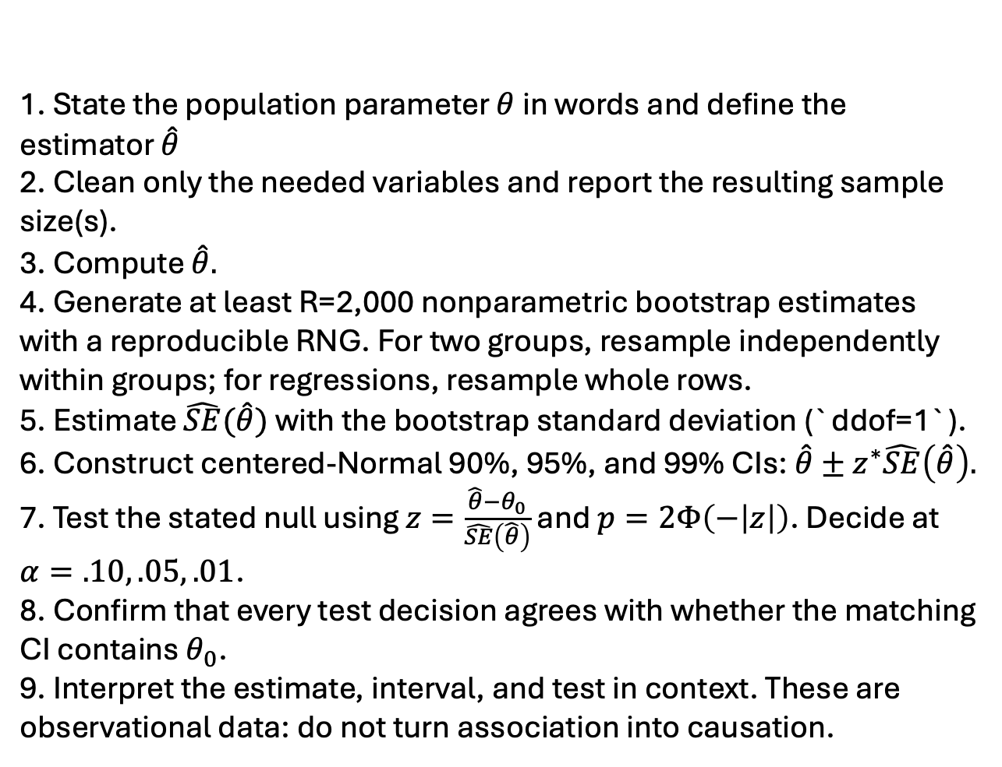
1. State the population parameter $θ$ in words and define the estimator $\hat{θ}$
2. Clean only the needed variables and report the resulting sample size(s).
3. Compute $\hat{θ}.$
4. Generate at least R=2,000 nonparametric bootstrap estimates with a reproducible RNG. For two groups, resample independently within groups; for regressions, resample whole rows.
5. Estimate $\hat{SE}(\hat{θ})$ with the bootstrap standard deviation (`ddof=1`).
6. Construct centered-Normal 90%, 95%, and 99% CIs: $\hat{θ}±z^{∗}\hat{SE}\left(\hat{θ}\right).$
7. Test the stated null using $z=\frac{\hat{θ}−θ_{0}}{\hat{SE}\left(\hat{θ}\right)}$ and $p=2Φ\left(−\left|z\right|\right)$. Decide at $α=.10, .05, .01$.
8. Confirm that every test decision agrees with whether the matching CI contains $θ_{0}$.
9. Interpret the estimate, interval, and test in context. These are observational data: do not turn association into causation.
Inference routine:
bootstrapping an estimate to understand its uncertainty
EXPLORE the data non-parametrically before modeling
ESTIMATION: decide on what’s important
INFERENCE: non-parametric bootstrap evaluation of parameters
PREDICTION (and quantifying the uncertainty of predictions)
Notes:
Non-parametric exploration of data before explicit modeling
Non-parametric bootstrap evaluation of parameters or predictions, in every assignment
For these models, ESTIMATION and then INFERENCE and then PREDICTION in every lab
Focus on the idea and the application (e.g. count data and Poisson), rather than a mathematical derivation
Our job is INFERENCE about parameters and quantifying the uncertainty of PREDICTIONS; we're not worried about the machine learning part, but about exploiting the inference framework we've built using resampling to instill a worldview in the students that resampling methods are the natural solution to most problems

Slide 25
Does It Pay for Itself?
A retail chain pilots an energy-management system in 5 stores. It costs $200 per store per month. Monthly savings on each store's electric bill: $100, $300, $400, $500, $700
1. Compute x̄, s², and the estimated SE
2. Build a 95% CI with 1.96. Does the system save money at all? (Test H₀: average savings = 0)
3. Does it pay for itself? Is the $200 break-even inside or outside your CI?
4. The CFO writes: "There is a 95% chance the system saves between $204 and $596 per store." Rewrite it correctly: 4. "If we ran this pilot on 5 new stores many times, about 95% of the intervals built this way would contain the true average savings." The true savings is fixed: it is either in ($204, $596) or it isn’t
5. All 5 pilot stores are in Phoenix. What does your CI tell you about the stores in Maine?
Notes:
1. x̄ = 20/5 = 4 ($400). Deviations −3, −1, 0, 1, 3, so the sum of squares is 20 and s² = 20/4 = 5. SE = √(5/5) = 1 ($100)
2. 4 ± 1.96 × 1 = ($204, $596). 0 is outside, so reject H₀: it saves money (the estimate is 4 SEs from 0)
3. The lower end, $204, is just above $200: it pays for itself, barely
4. "If we ran this pilot on 5 new stores many times, about 95% of the intervals built this way would contain the true average savings." The true savings is fixed: it is either in ($204, $596) or it isn’t
5. Not much. The interval targets Phoenix stores, where air conditioning drives the bill. More Phoenix stores would shrink the SE but not change the target (like the landline poll)

Slide 26
In class challenge
At stake: bonus points on Lab 7 smgroves.github.io/ds5030-uncertainty-plots

Slide 27
Coding example
Load the Metabric breast cancer dataset, and describe/plot `Overall Survival (Months)`.
Describe a strategy for selecting variables that you'll use to predict `Overall Survival (Months)`, then implement your strategy and run your regression.
Construct 90/95/99% non-parametric Bootstrap confidence intervals for the coefficients of your regression, as well as ones based on the Normal approximation using the standard deviation of the bootstrap sample as the standard error of the sampling distribution. How do they compare?
Which variables are statistically significant, and at what levels?

Slide 28
Summary

Slide 29
Five Things to Think About
The parameter is fixed but unknown. We're trying to learn something about a property of the population.
Our estimates/confidence intervals are random variables of the data. Different samples produce different estimates, even for the same population doesn't change.
The standard error measures variability in our estimators, and bootstrapping gives us a practical way to estimate it.
The confidence interval translates variability into uncertainty about the parameter. Under the Normal approximation, that's . A hypothesized value outside the corresponding interval is rejected as implausible give the data and estimator.
The Bootstrap and the CLT are different approaches to understanding the underlying sampling distribution and making inferences about it, with their own strengths and weaknesses.

Slide 30
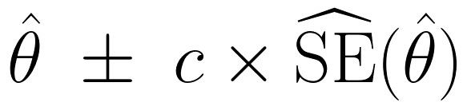
Summary
The standard error is the standard deviation of the sampling distribution
The bootstrap estimates the spread and shape of the sampling distribution from one sample
The CLT says that, standardized, the sampling distribution is approximately N(0, 1): that's why the bootstrap pictures all looked the same
So we can replace bootstrap quantiles with ±1.645, 1.96, 2.576:
A CI is a reliability claim about the procedure. A test asks whether the null value is inside the CI
It breaks with dependence, heavy tails, small samples of skewed data, and estimates that aren't averages

Slide 31
Is the SE Itself Uncertain?
Yes: the estimated SE comes from the same sample, so it has its own sampling distribution
For normal data, its typical relative error is about 1/√(2(n − 1)): 35% at n = 5, 24% at n = 10, 7% at n = 92
Too small an SE hurts more than too big helps, so coverage drops
The t-distribution fixes this exactly for normal data; for skewed data it helps but can't fix it
n | normal: z | normal: t | cars: z | cars: t
5 | 87.5% | 94.8% | 78.3% | 86.2%
10 | 92.2% | 95.3% | 85.0% | 88.1%
30 | 94.0% | 95.1% | 91.8% | 92.7%
92 | 94.9% | 95.2% | 93.9% | 94.2%
Coverage of a nominal 95% interval (20,000 simulated samples each)

Slide 32
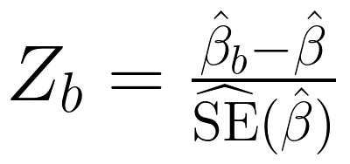
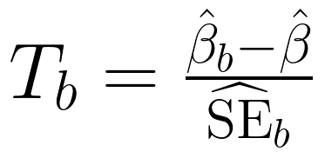
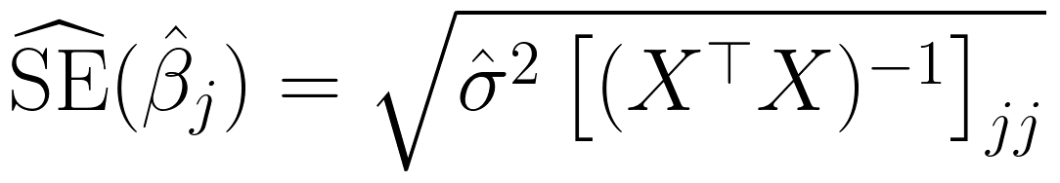
More on Standard Errors
Standard errors are important but hard to pin down: the data and model create the standard error
We've been using the SD of the bootstrap sample as the SE. This is the centered bootstrap:
If you can get an SE from each resample, you can upgrade to the studentized version, which has more variation because the SE is allowed to vary:
The analytical formula for OLS standard errors (you can bootstrap this by resampling rows):

